Slide 1

Zimbabwe Herd Book
Breeder Requirements
Course Notes

Slide 2
ZHB
Data Registry maintaining
Herd Books for Societies

Slide 3
Software
ILR2
International Livestock Registry 2
Animal registry service for data recording, maintenance, enquiry, and reporting
Developed by ABRI (Agricultural Business Research Institute) in Australia
BreedPlan
Modern genetic evaluation system for beef cattle breeders
Analyses the data recorded in ILR2

Slide 4
Births
New calves are entered with birth notifications
They are not yet fully Registered (REG)
Instead, they are first placed in Calfbook (CB)

Slide 5
Inspections
Animals that pass inspection are upgraded from Calfbook (CB) to Registered (REG)
Animals that fail inspection are downgraded to Commercial (COM)

Slide 6
Transfers
Local sellers need to authorise the transfer of any animals sold to other ZHB members
Imported animals need a proof of purchase or a proof of transfer in a foreign database
Registration certificates, animal details, and pedigree data need to be sent to ZHB
Data extracts from foreign databases make entering the animal’s data easier

Slide 7
Cancellations
Includes anything that removes the animal as a registered stud animal
Also referred to as disposal or fate
Fate code and date sent to ZHB

Slide 8
Appendix A
Calf born to at least one commercial/unknown parent
First birth notified as Commercial (COM)
After passing inspection upgraded to Registered Appendix A

Slide 9
System of Animal Identification

Slide 10
ZHB ID
Also known as Society ID
In the format YY-NNNNHHH e.g. 21-0036ABC
YY, 2 digit calving year e.g. 21
NNNN, 4 digit zero padded calf number (unique for the year) e.g. 0036
HHH, a member’s Herd Designation Letters - a unique code of 1 to 3 characters e.g. ABC

Slide 11
On-Farm ID
All animals must have two means of identification
Combination of:
Tattoo
Brand
Ear tag(s)
Ear notches

Slide 12
Animal Name
Stud/Herd name combined with On Farm ID
Could also include a given name as well

Slide 13
National ID
Optional
Unique code on tags sold for the Livestock Identification and Traceability System (LITS)

Slide 14
On Farm Recording

Slide 15
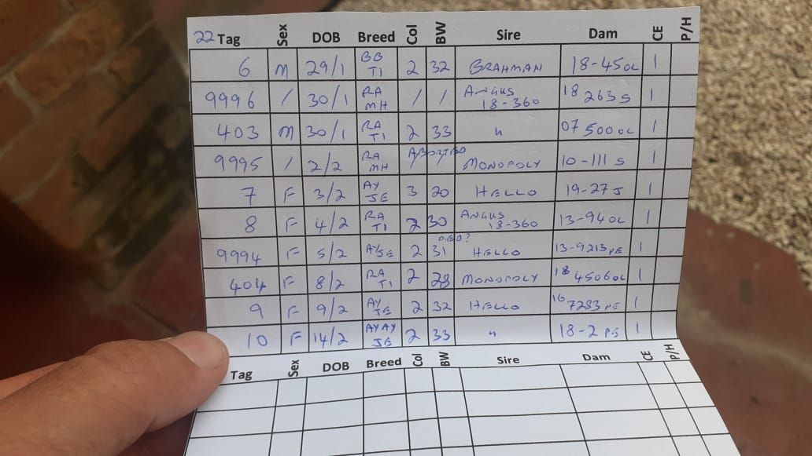
On Farm Recording

Slide 16
Birth Notifications

Slide 17
Birth Notifications
Calf Details
Society ID
Date of Birth
Sex
Appendix
Name
Mating Details
Mating type
Mating date
Pedigree
Sire
Dam
Breed code
Calving Details
Number in Birth
Birth Weight
Performance Group
Birth Fate

Slide 18
Birth Notifications
Must be sent within 60 days of calf’s birth
Aborted and stillborn calves still need to be sent
Sent via
HerdMASTER
Excel Template
Hard Copy

Slide 19
Birth Notifications

Slide 20
Birth Notifications

Slide 21
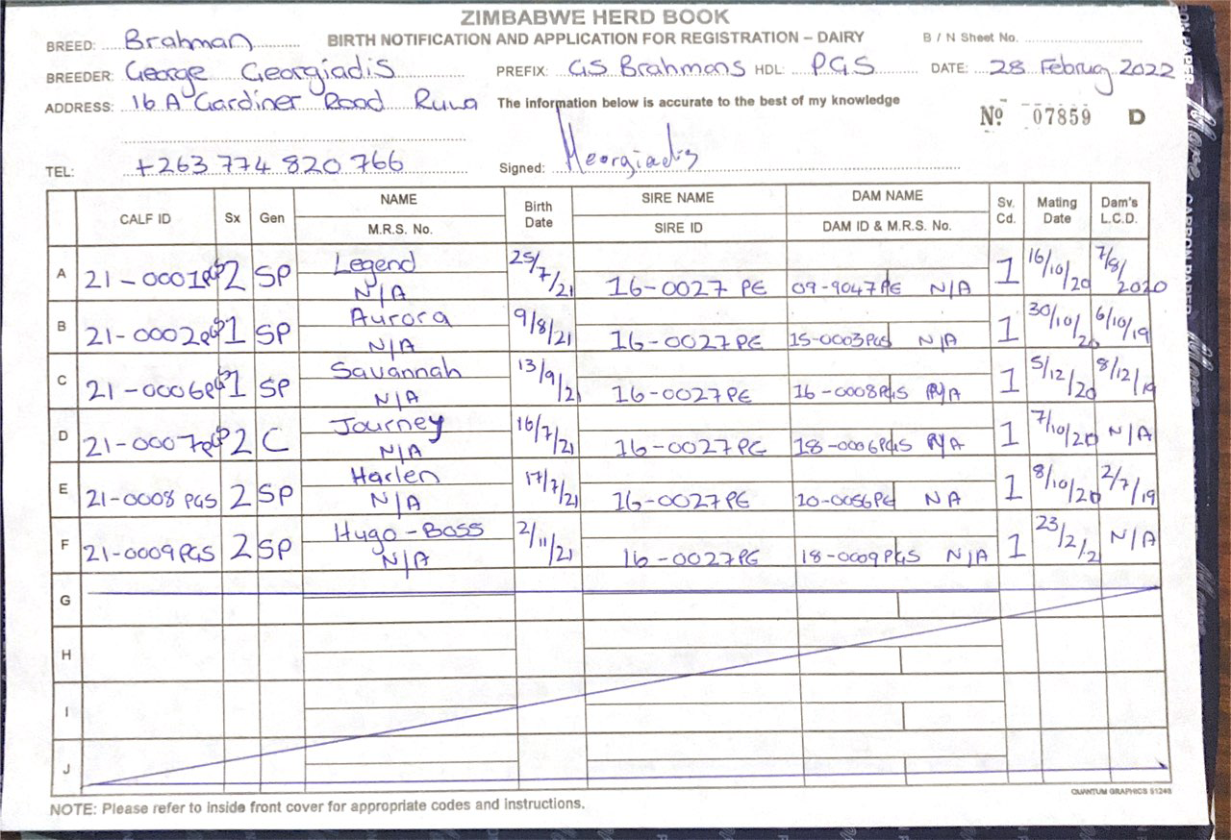
Birth Notifications

Slide 22
Multisires
Group of two or more bulls that runs with a group of cows
The group is given a unique id in the format HDLYYMULTNNN eg. ABC21MULT001
HDL, Herd Designation Letters
YY, year the group is used
MULT, identifies the group as a multisire
NNN, unique zero padded group number for that year

Slide 23
Multisires
Before the calves are born, ZHB should be notified of the multisire and which bulls are in it
If it does not yet have an ID, one will be created
A new group should be created each year, even if the same bulls are used
Multisire Appendix depends on the society

Slide 24
Request For Information (RFI)

Slide 25
Request For Information (RFI)
When the information in a animal’s birth notification conflicts with the data already on the ZHB system the animal is entered as a Held Animal with an id ?001
Conflicts can include
the dam dying before the calf’s date of birth
missing parent
calving interval too short
parent has not passed inspection
etc.

Slide 26
Request For Information (RFI)
Request For Information reports contain the Held Animals for a member and the reasons why they are being held
Members should check that their information is correct both in their own records and ZHB’s database
Once the conflicts are resolved the Held Animal can be entered correctly

Slide 27
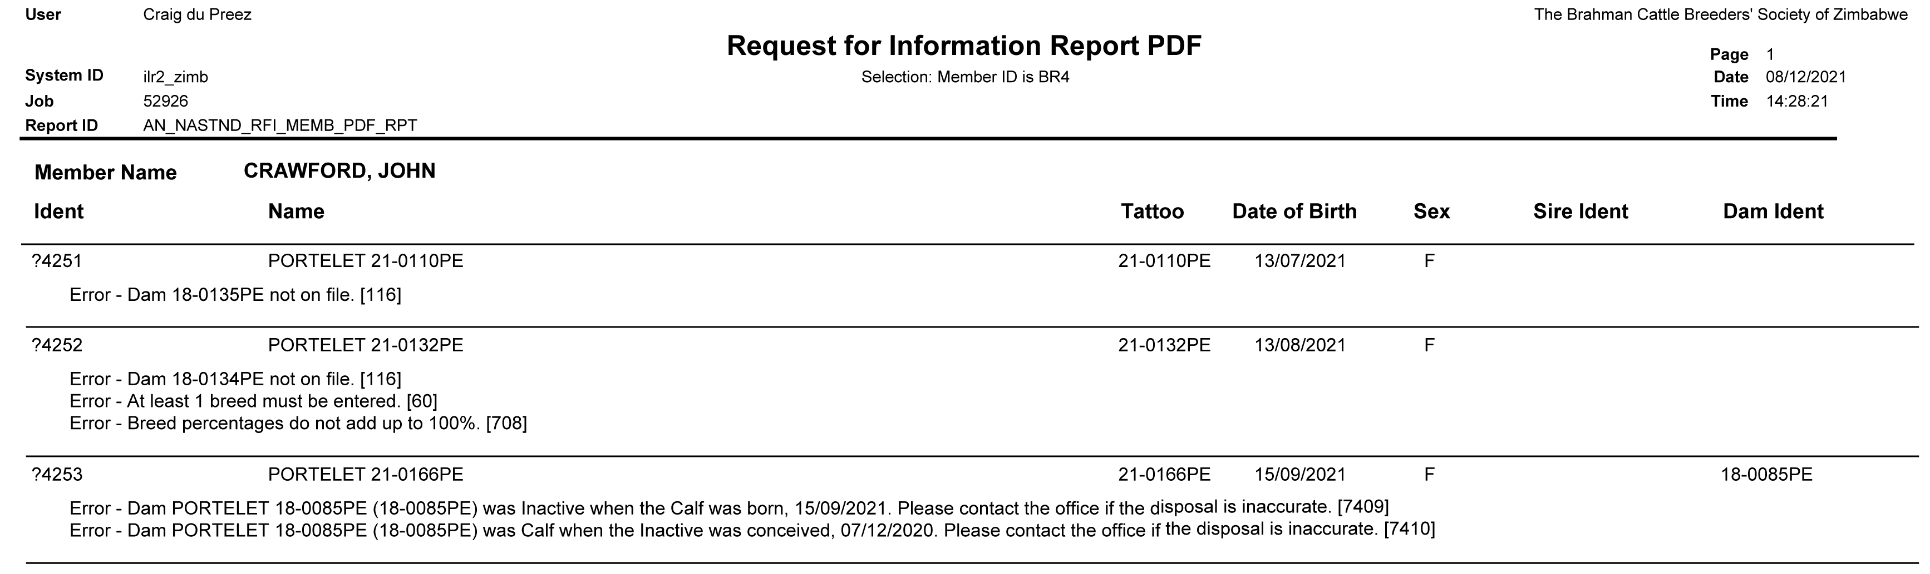
Request For Information (RFI)

Slide 28
Sales

Slide 29
Sales
Before the sale of any stud/registered/pedigree animal, clearance must first be obtained from ZHB
ZHB needs to ensure that the animal is properly registered, it must
Be birth notified
Have its pedigree known
Have a stored DNA sample
Be inspected if of age
Registration Certificates can be generated for inspected animals

Slide 30
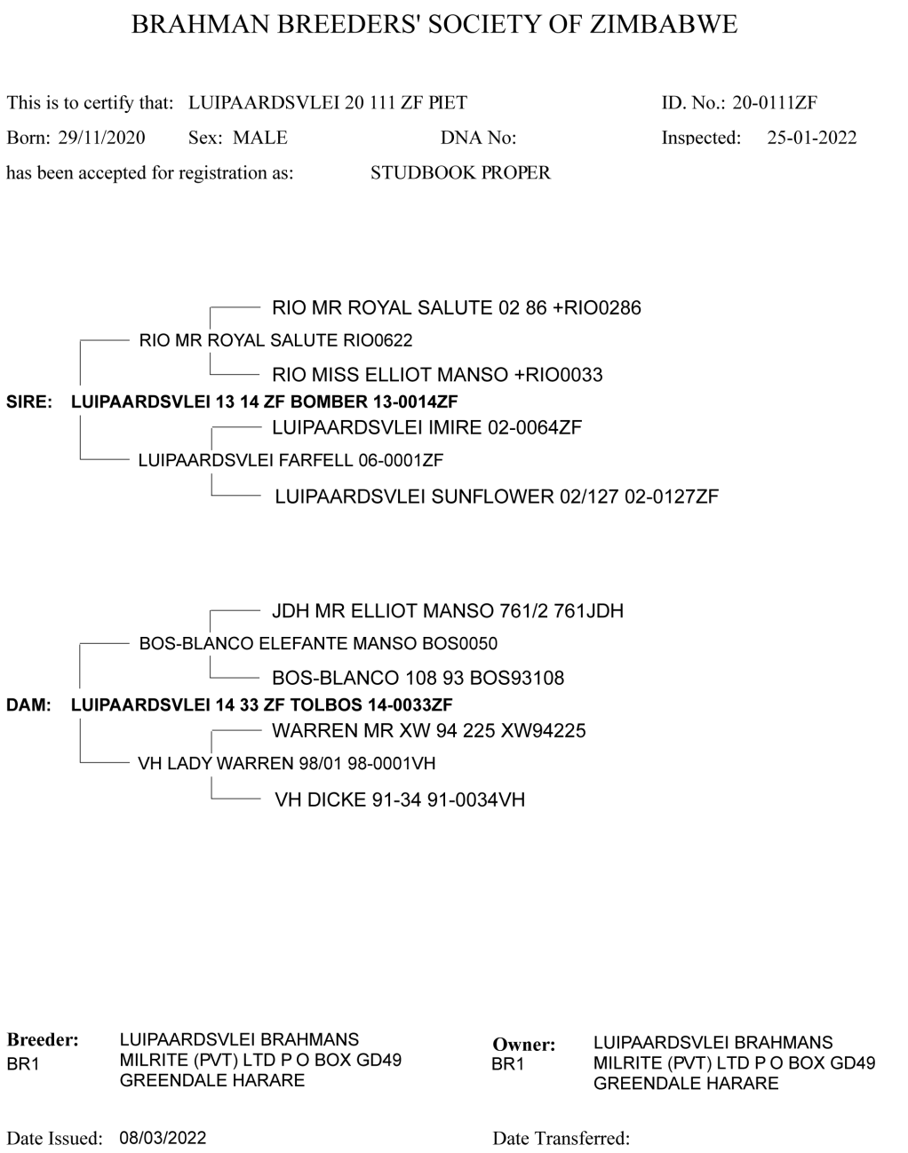
Registration Certificate

Slide 31
Cancellations

Slide 32
Cancellations
Fate/Disposal codes and dates for
Deaths
Thefts
Culls for fertility
Culls for other reasons
Sales to non-ZHB member
Movements to a commercial herds
Sent via
HerdMASTER
Excel Template
Hard Copy

Slide 33
Performance Records

Slide 34
Contemporary Groups
Animals born within 45 to 60 days of each other of the same herd, year, sex and performance/management group that are then compared to each other during analysis
User defined performance/management groups are assigned to animals that have been treated differently which may affect their performance
Sickness, Extra Feed, Different Location, etc.

Slide 35
Weights
Birth weight
within 24 hours of birth and sent with a Birth Notification
200d (W2, pre-weaning)
between 80 – 300 days of age before weaning
400d (W4, yearling)
between 301 – 500 days of age
600d (W6, 18 month)
between 501 – 900 days of age

Slide 36
Weights
Cow weight at calving (AC),
cow’s weight when her calf is born
Mature Cow weight (MA),
cow’s weight when her calf’s 200d weight is taken

Slide 37
Weights
Ideally all animals in the same performance group should be weighed on the same day if they fall within the appropriate age range
Measured to the nearest kg
Up to 2 weights can be submitted for W2, W4, and W6
Multiple weights can be submitted for MA and AC
Sent via
HerdMASTER
Excel Template
Hard Copy

Slide 38
Scrotal Size
Recorded between 300 – 700 days of age, recommended when 400d weights are taken
Measured in cm to 1 decimal place
Sent via
HerdMASTER
Excel Template
Hard Copy

Slide 39
Weights, Scrotal Size, & Cancellations Excel Template

Slide 40
Days To Calving (DTC)
Requires a fixed mating season
All matings should be recorded including ones that failed to produce a calf
Mating details include
Cow ID
Mating type
Bull in date
Bull out date
Management group

Slide 41
Days To Calving (DTC)
Pregnancy tests can also be recorded
Female disposal information needs to be recorded if a cow is removed from the herd
different to an animal cancellation
Sent via
HerdMASTER
Excel Template
Hard Copy

Slide 42
DTC Excel Template

Slide 43
DTC Excel Template

Slide 44
Other Traits
Hip height
Flight Score
Sheath and Navel Score
Feed Efficiency
RTU Scanning
Meat Quality

Slide 45
DNA Sample

Slide 46
Parent Verification
Currently microsatellite markers are used to confirm the sire and dam of a calf
Samples need to be taken from the calf and the parents or the parents need to have a profile on record in the processing lab

Slide 47
Genetic Profile
Once a DNA sample has been processed a profile is created for that animal
This profile can be used for future progeny parent verification

Slide 48
Sampling
At least one DNA Sample Type is stored at ZHB, a requirement to fully Register an animal
Pulled tail hairs (20 to 30) with follicle
in an envelope with the animal’s details written on it
in a specialised hair card with the animal’s details written on
Tissue sample
in a vial with a preservative with animal ID written on it
Semen sample
dried semen from a straw used for Artificial Insemination

Slide 49
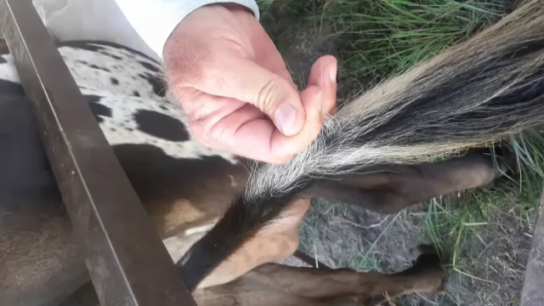
Sampling

Slide 50
Hair Sample Card

Slide 51
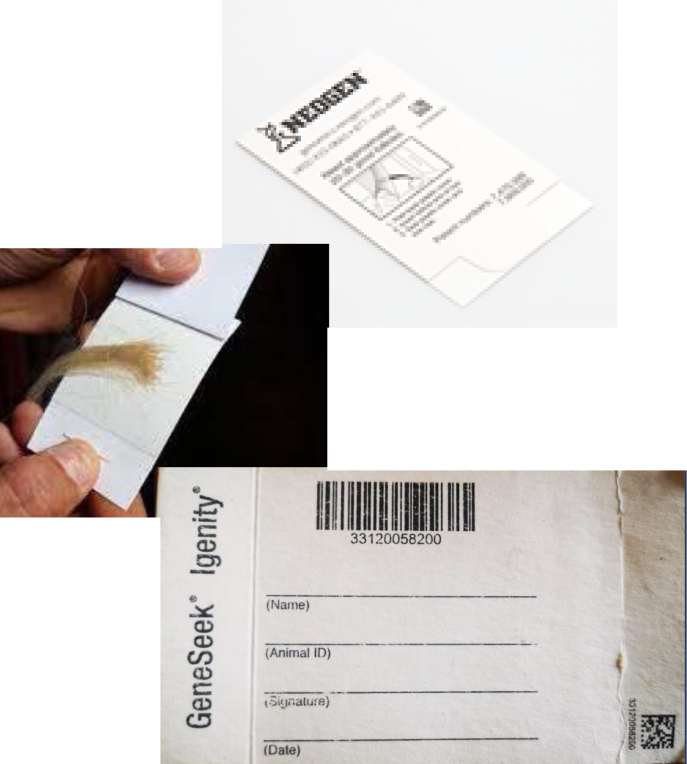
Neogen Hair Card

Slide 52
Inspection List

Slide 53
Annual
Inspections are carried out annually according to the breed society’s standards for animals that are currently in Calfbook and potential Appendix A animals
Inspection lists are Generated by ZHB
can be separated by sex

Slide 54
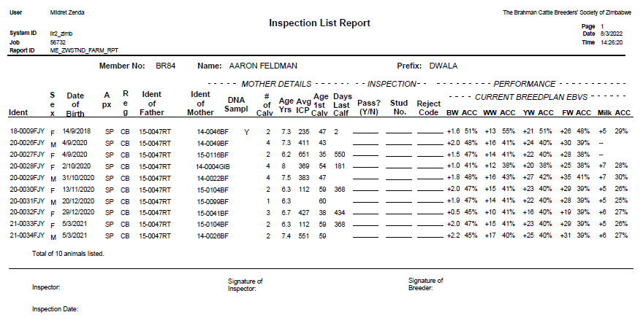
Inspection List

Slide 55
Calfbook, Commercial, and Registered
All new calves are entered into the ZHB system as either Calfbook or Commercial
New calves with fully registered parents are entered as Calfbook
New calves where one or both parents are unknown/commercial are entered into the ZHB system as Commercial
For foreign breeds, non-SP males are entered as Commercial

Slide 56
Calfbook, Commercial, and Registered
Once animals reach the age determined by their breed society, animals currently in Calfbook and potential Appendix A animals can be inspected
If an animal passes inspection and a sample of its DNA is stored at ZHB, it is upgraded to Registered
If an animal fails inspection, it is downgraded to Commercial

Slide 57
Breed Standards
Each breed society has their own rules regarding inspections
Depending on the breed society, inspections are done by
self-inspection
a fellow breeder
a designated inspector
Each breed society has their own specifications for what animals can be considered true to type

Slide 58
Levy List

Slide 59
Levy List
Lists the animals that are being levied
Includes all active Calfbook and Registered animals born before the previous year e.g. 2022 levy lists include animals born before 01/01/2021
Can be generated in pdf or excel format

Slide 60
Levy List
Members need to confirm that the animals and their details match those that they have in their own records
Returns are due by the end of February
Herd and per capita levies

Slide 61
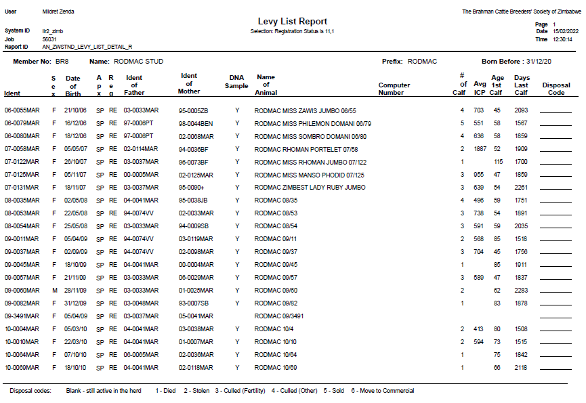
Levy List

Slide 62
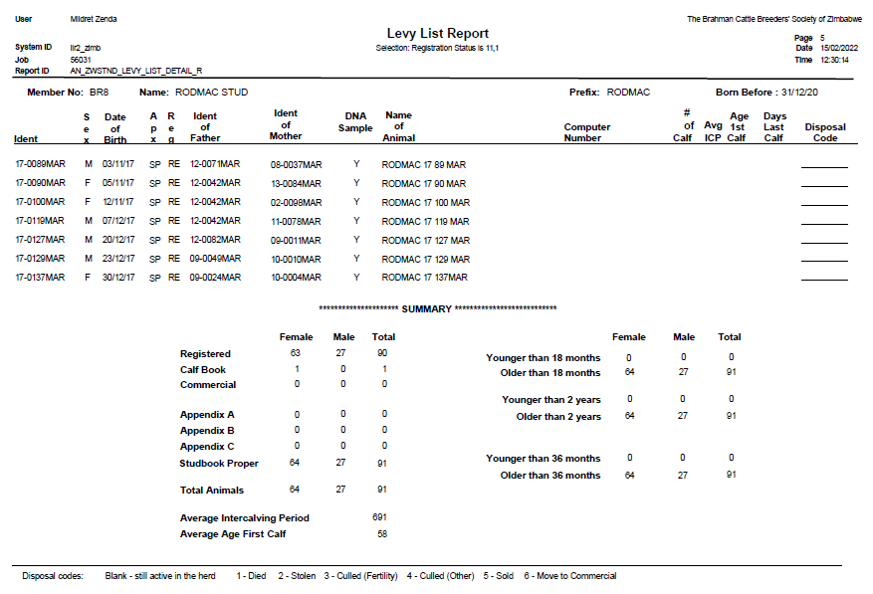
Levy List

Slide 63
Herd Lists

Slide 64
Herd Lists
Can be generated at any time upon request
Lists all active animals and their details in a member’s herd
Or list specific animals by registration status, sex, and calving year
Generated in pdf and Excel format

Slide 65
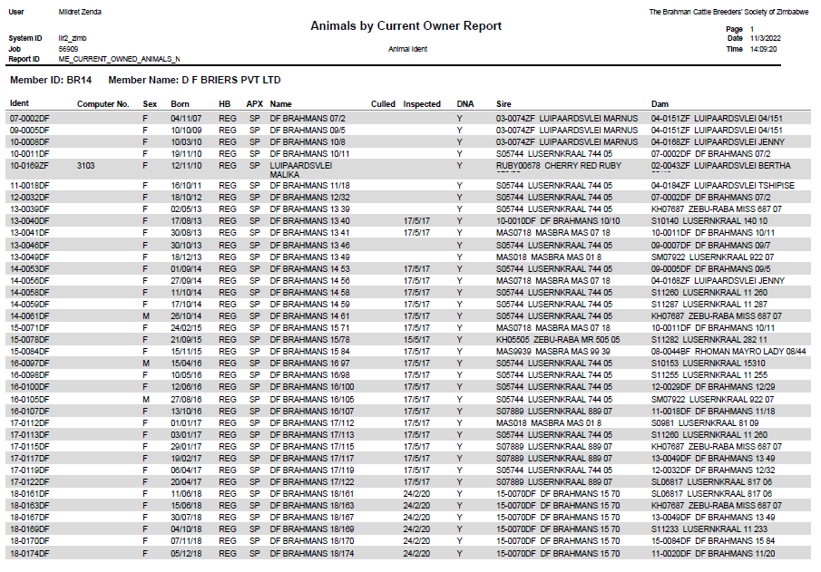
Herd Lists

Slide 66
Internet Solutions

Slide 67
Internet Solutions
http://www.lrf.co.za/zimbabwe/
Online searchable database of all animals and their details on the ZHB system
ZHB members can request a login password for their member id
Once logged in, members have access to their EBV reports, Outlier reports, Levy Lists, and Data Extracts

Slide 68
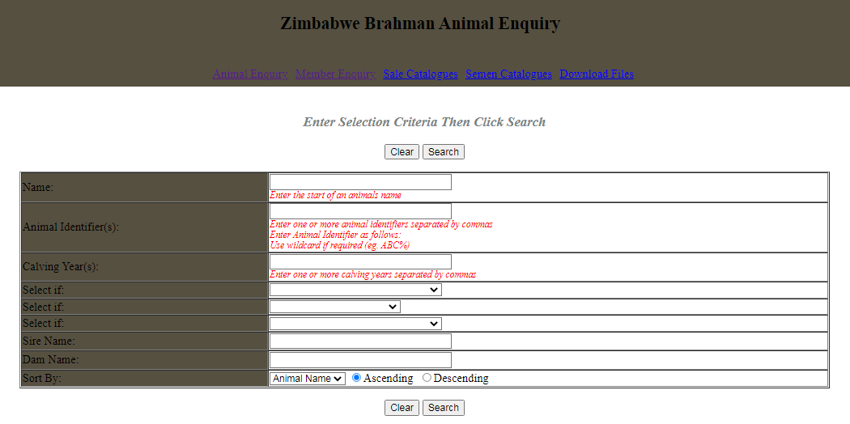
Internet Solutions

Slide 69
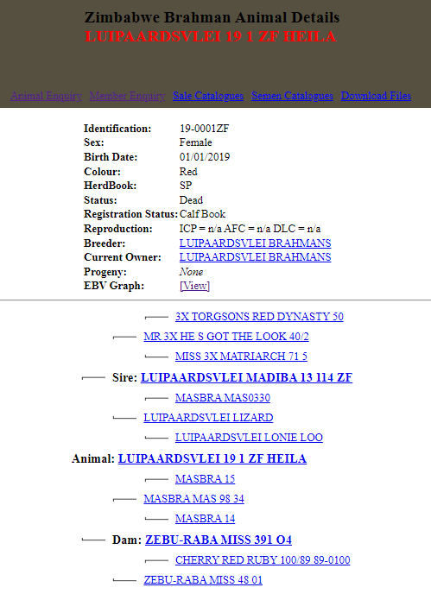
Internet Solutions

Slide 70
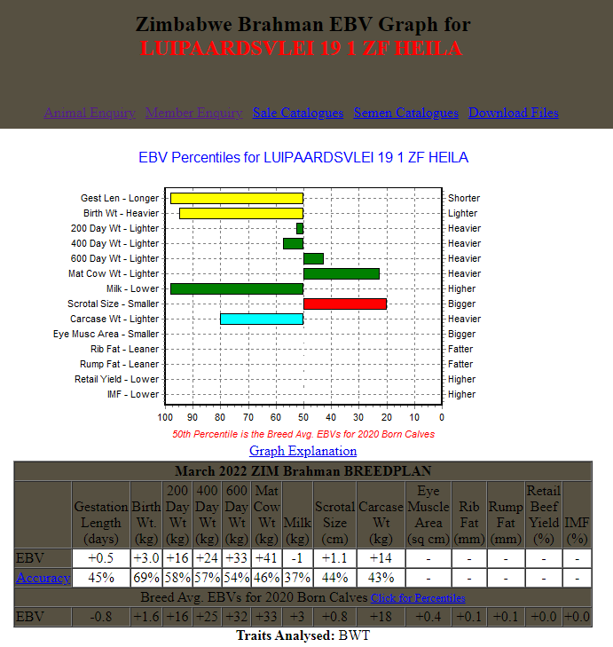
Internet Solutions

Slide 71
Breed Runs

Slide 72
Estimated Breeding Values
An animal's breeding value is its genetic merit, half of which is passed onto its progeny
It is estimated from its performance and that of its relatives
EBVs are expressed as the difference between an individual animal’s genetics and its breed’s genetic base
Breed Runs calculate updated Estimated Breeding Values for all animals if they or their relatives have performance data

Slide 73
Herd Reports
Generated quarterly after a Breed Run is done for members that have submitted performance data that year

Slide 74
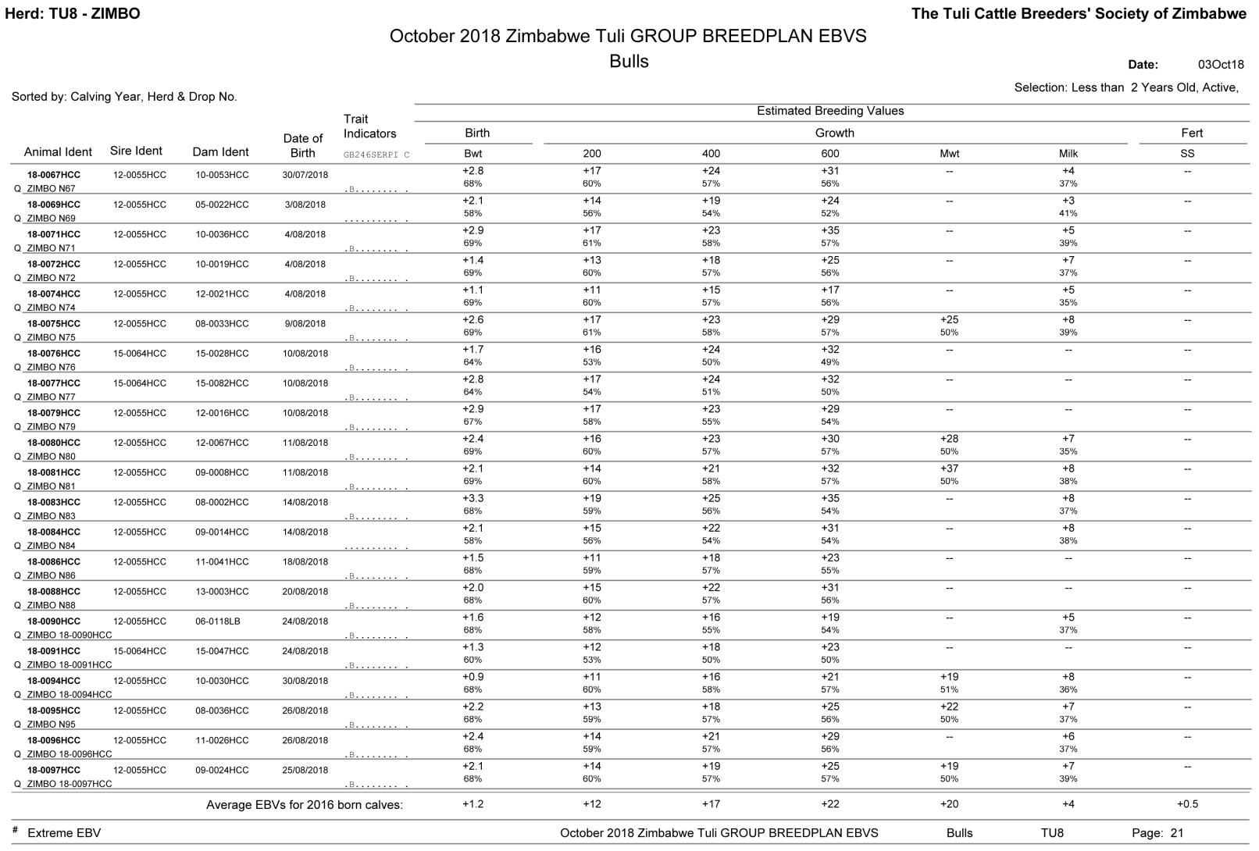
Contain updated EBVs for all active animals 2 years old or less and their parents in a member’s herd

Slide 75
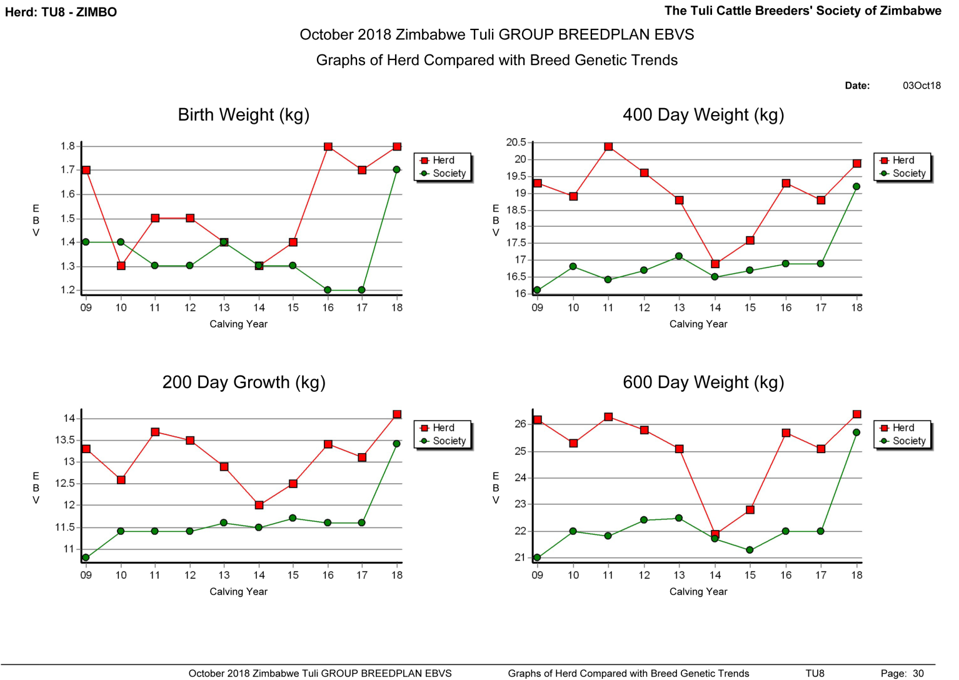
Contain the member’s average herd EBVs for 2 year old animals and how they compare to the average breed EBVs for 2 year old animals

Slide 76
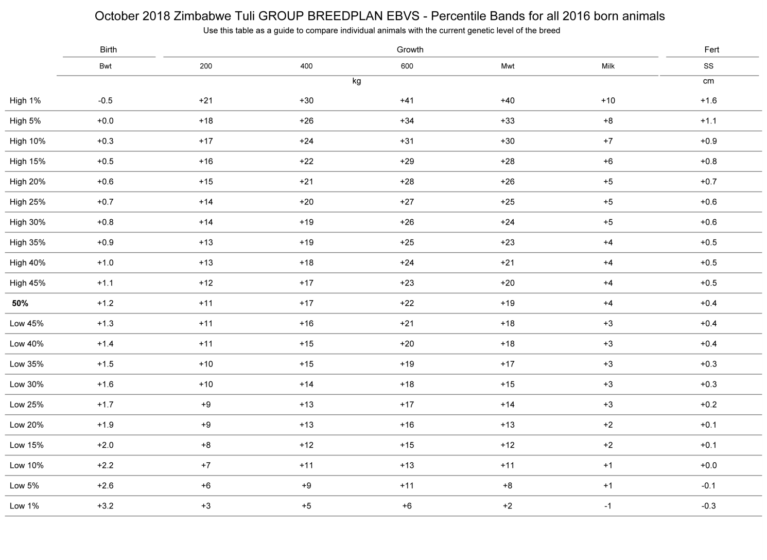
Contain a percentile bands table which shows the various EBVs for the top percentage of animals

Slide 77
Outlier Reports
A performance record for an animal can be much higher or lower when compared to other records in its contemporary group
During a Breed Run, these records are flagged as outliers and excluded from the Breed Run
They could be errors in recording or they could be valid

Slide 78
Outlier Reports
Members need to check and correct the error or confirm the record is valid
Once confirmed as valid or changed it will be included in the next Breed Run

Slide 79
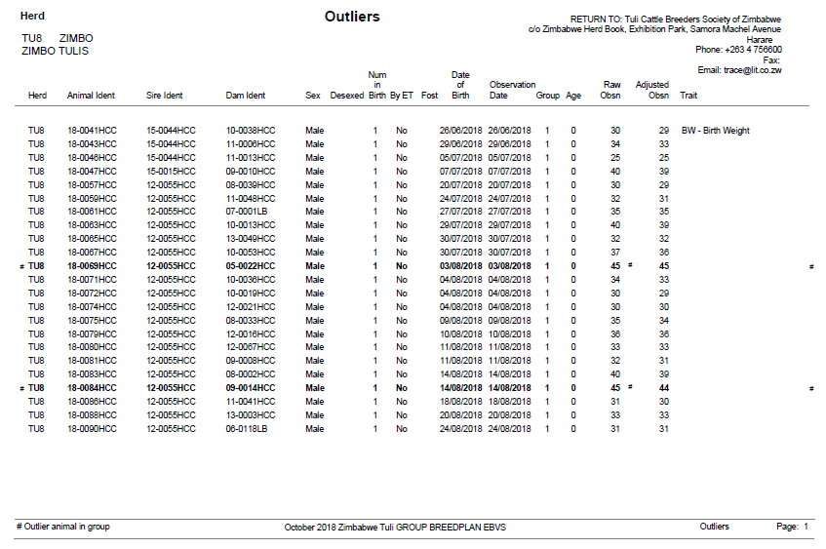
Outlier Reports

Slide 80
Calendar Year vs Calving Year

Slide 81
Calendar Year vs Calving Year
For members with year-round calving, animals are treated as distinct groups within a Calendar Year
for 2021 born calves, the id of all calves starts with year of birth 21
For members with a calving season that extends over the calendar year, provisions can be made in BreedPlan to identify these animals as being in the same calving contemporary group

Slide 82
Calendar Year vs Calving Year
This will avoid splitting the contemporary group in genetic analyses according to calendar year
Members will need to confirm their Calving Year
with a calving season extending from September to March, the Calving Year could be defined as April to March
all calves born from 1st April 2021 to 31st March 2022 will be given the same year of birth in their id 21

Slide 83
Timetable of Events

Slide 84
Timetable of Events
Birth
Birth Notification sent to ZHB
DNA Sample taken and sent to ZHB
200d
200d Weight recorded and sent to ZHB
400d
400d Weight recorded and sent to ZHB
Male Calf’s Scrotal Size recorded and sent to ZHB
600d
600d Weight recorded and sent to ZHB
2 years
Inspection takes place and results sent to ZHB

Slide 85
Timetable of Events
Mating
Mating Details recorded and sent to ZHB
Pregnancy Test recorded and results sent to ZHB
Calving
Cow’s Weight At Calving recorded and sent to ZHB
Weaning
Cow’s Mature Weight recorded and sent to ZHB
Mating Details, Pregnancy Test results, and Weights are recorded for each calving cycle and sent to ZHB
Cancellation
Fate Code and Date recorded and sent to ZHB
DTC Fate recorded and sent to ZHB

Slide 86
Introduction to Genomics

Slide 87
Microsatellite Markers
Piece of DNA with repeats and high mutation rates interspersed throughout an animal’s DNA
12 standard ISAG (International Society for Animal Genetics) markers are used for parentage verification
Results are not easily repeatable between labs
Time consuming to analyse

Slide 88
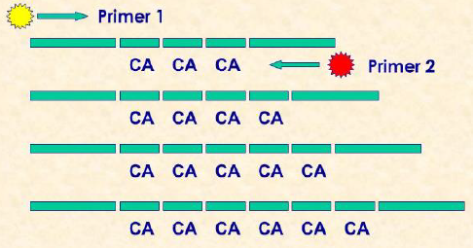
Microsatellite Markers

Slide 89
Single Nucleotide Polymorphism (SNP) Markers
Abundant and spread throughout an animal’s DNA at specific positions
Different variants exist that can affect an animal’s performance
Relatively easy to measure
Can be used for parent verification and other applications

Slide 90
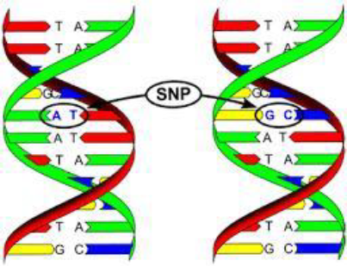
Single Nucleotide Polymorphism (SNP) Markers

Slide 91
Benefits of Genomics
Genomic Estimated Breeding Values can be calculated which means
more accurate pedigrees
the generation of accurate EBVs for young animals, hard to measure traits, single sex traits, traits that can only be measured after death, or animals that don’t have performance data
superior animals can be identified at a younger age so selection decisions can be made earlier which shortens generation interval and increases the rate of genetic improvement

Slide 92
Benefits of Genomics
Carriers of desirable traits and undesirable abnormalities can be detected
Parentage Verification
SNP uses 200 markers and microsatellite uses 12 markers
More markers means more accurate analysis allowing parents to be verified even among closely related animals

Slide 93
THANK YOU
For further information please contact
trace@lit.co.zw
Templates can be downloaded from
tinyurl.com/zhbtemplates
Latest course notes can be downloaded from
tinyurl.com/zhbbreederrequirements

